Slide 1
InsureAI Corporate Policy Automation and Intelligence System

Slide 2
Introduction:
Traditional insurance processes are manual, fragmented, and inefficient.
Customers and agents face delays in claims, policies, and appointments.
A modern digital platform is required to streamline workflows and improve user experience.
Features:
Role‑based dashboards for Admins, Agents, and Employees with real‑time updates.
Integrated modules for policies, claims, appointments, and payments.
Enhanced user experience with notifications, voice assistant, and compliance‑ready workflows.

Slide 3
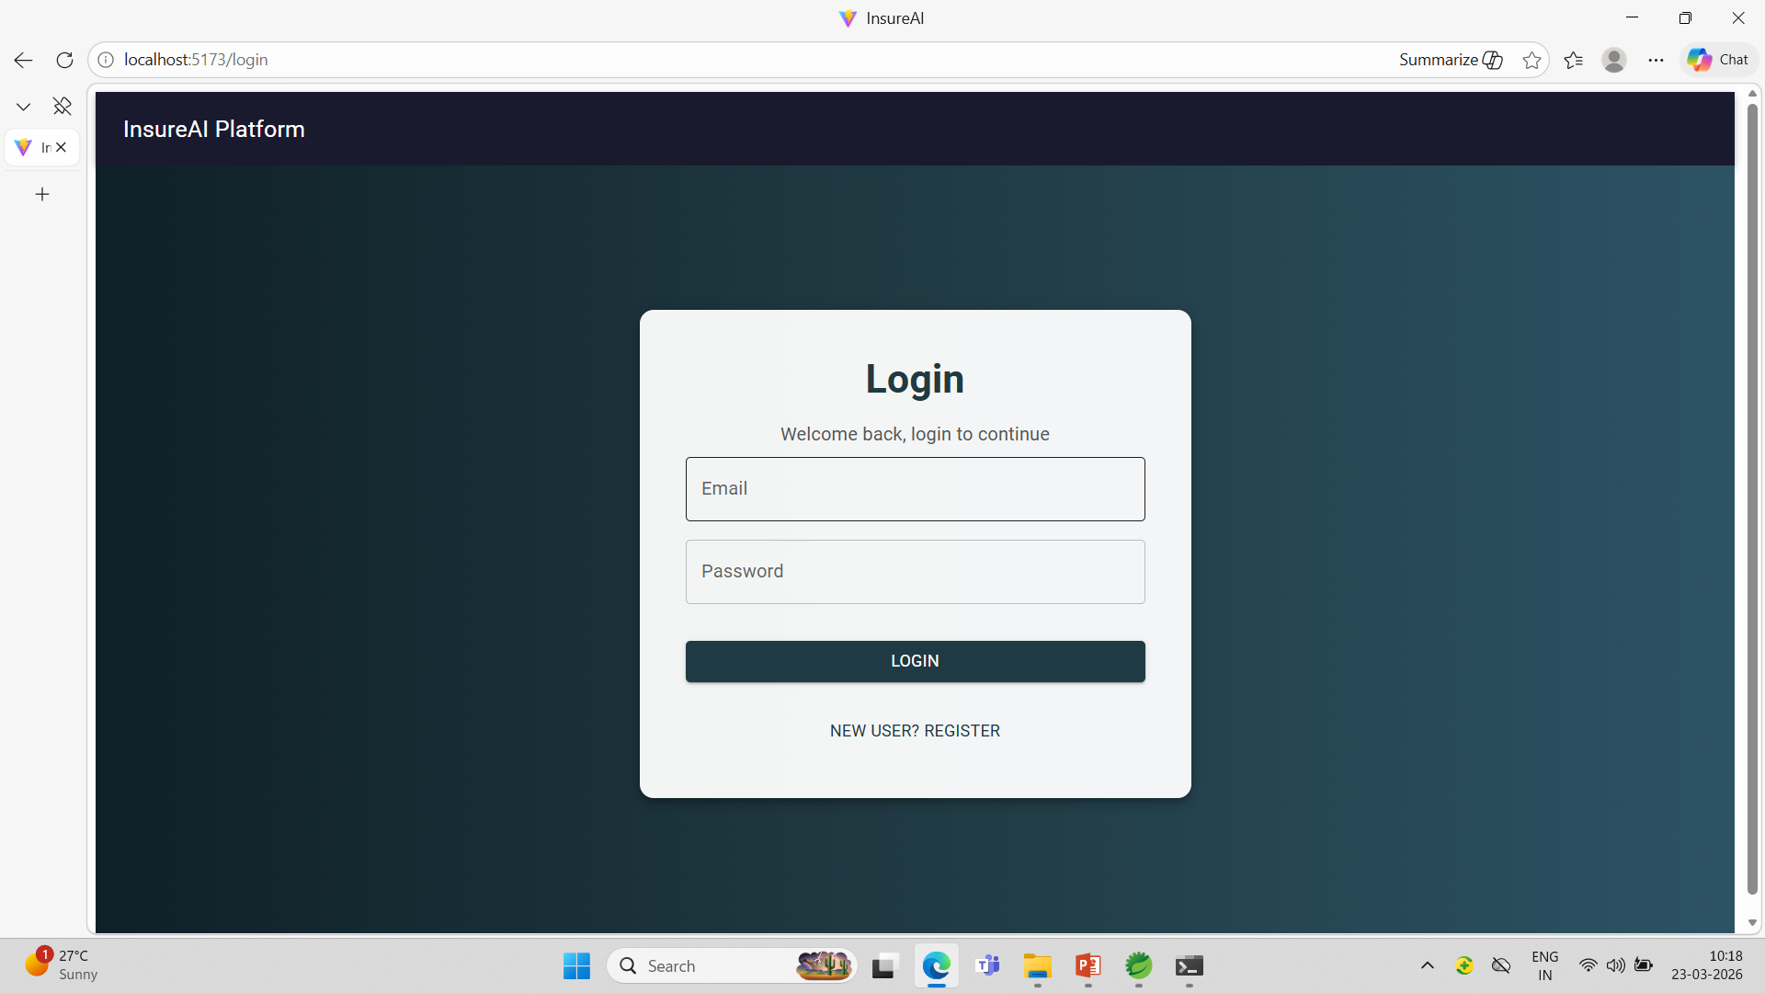
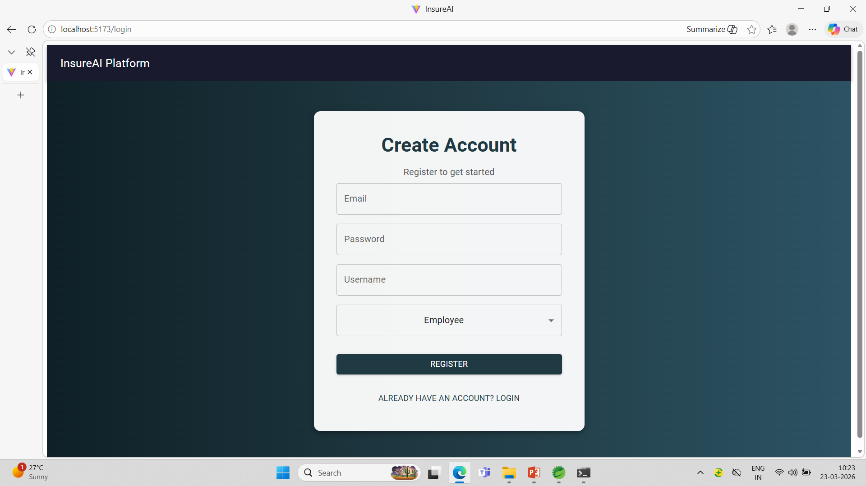
User Authentication and Registration

Slide 4
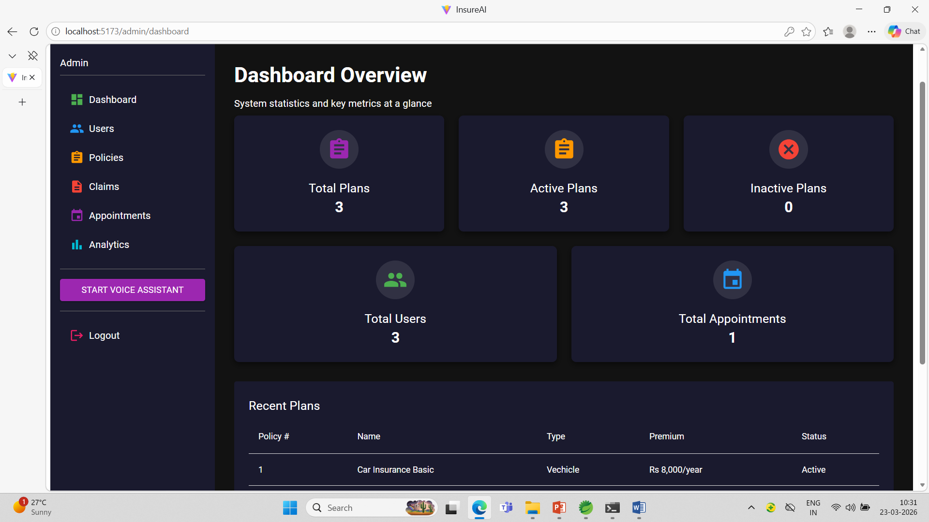
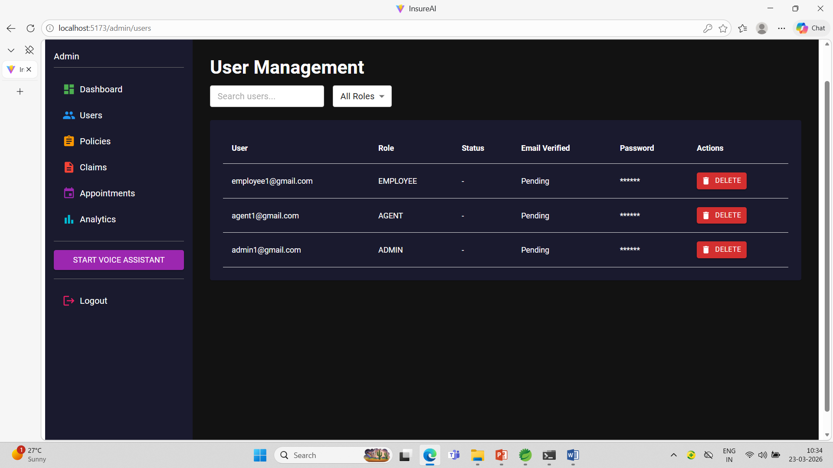
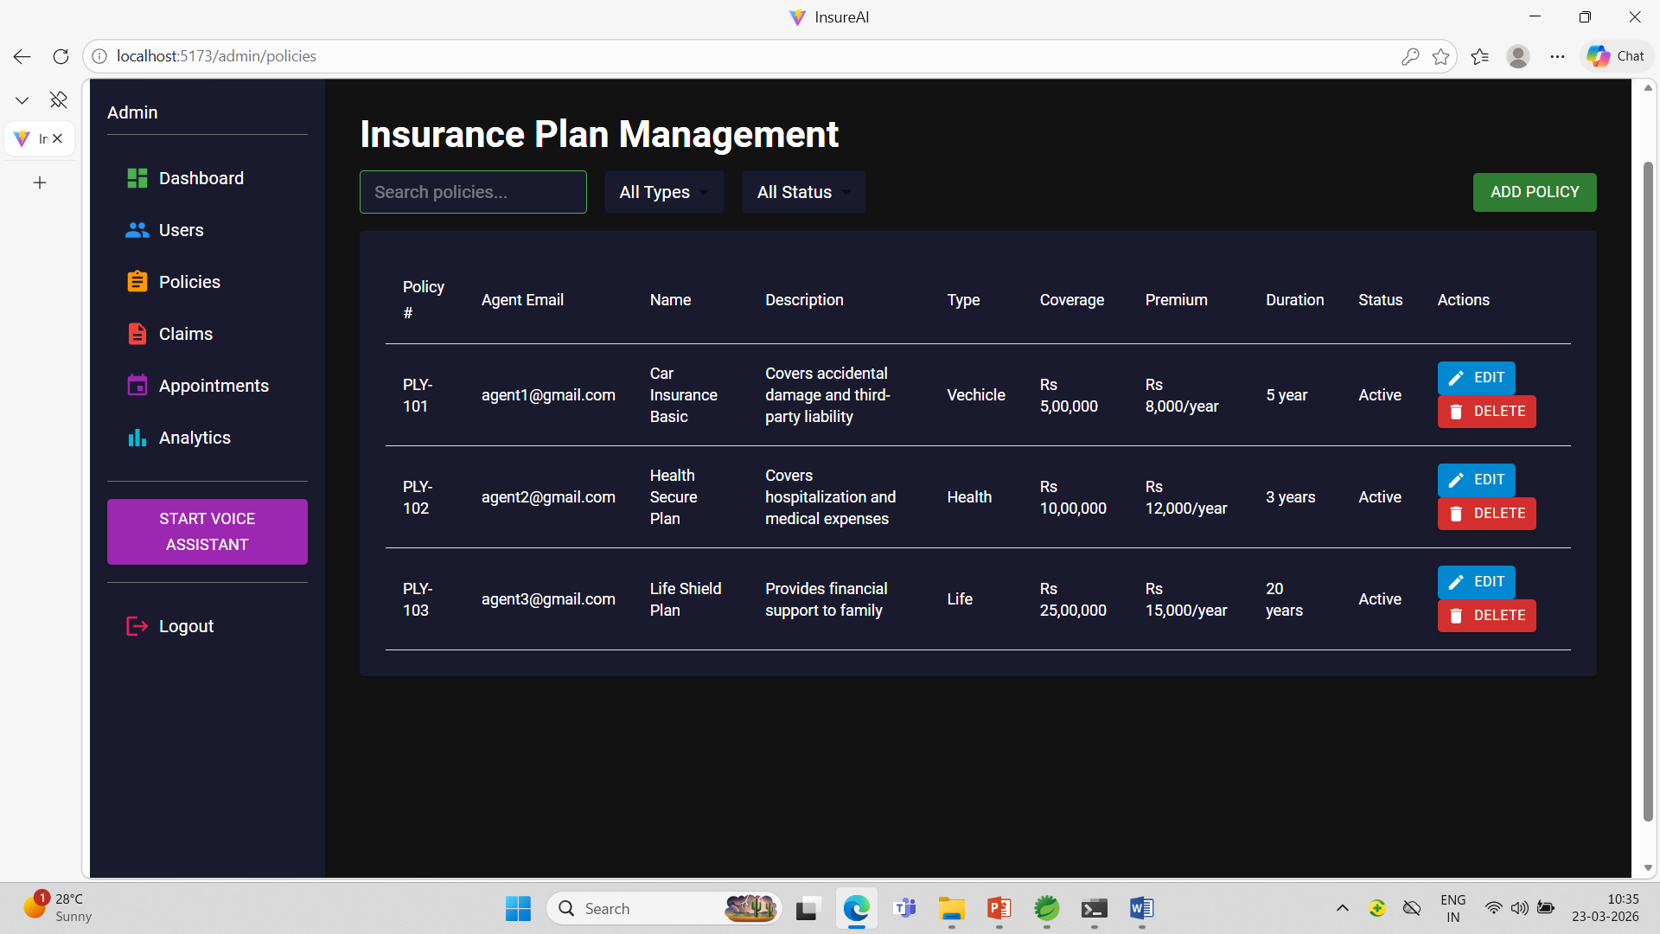
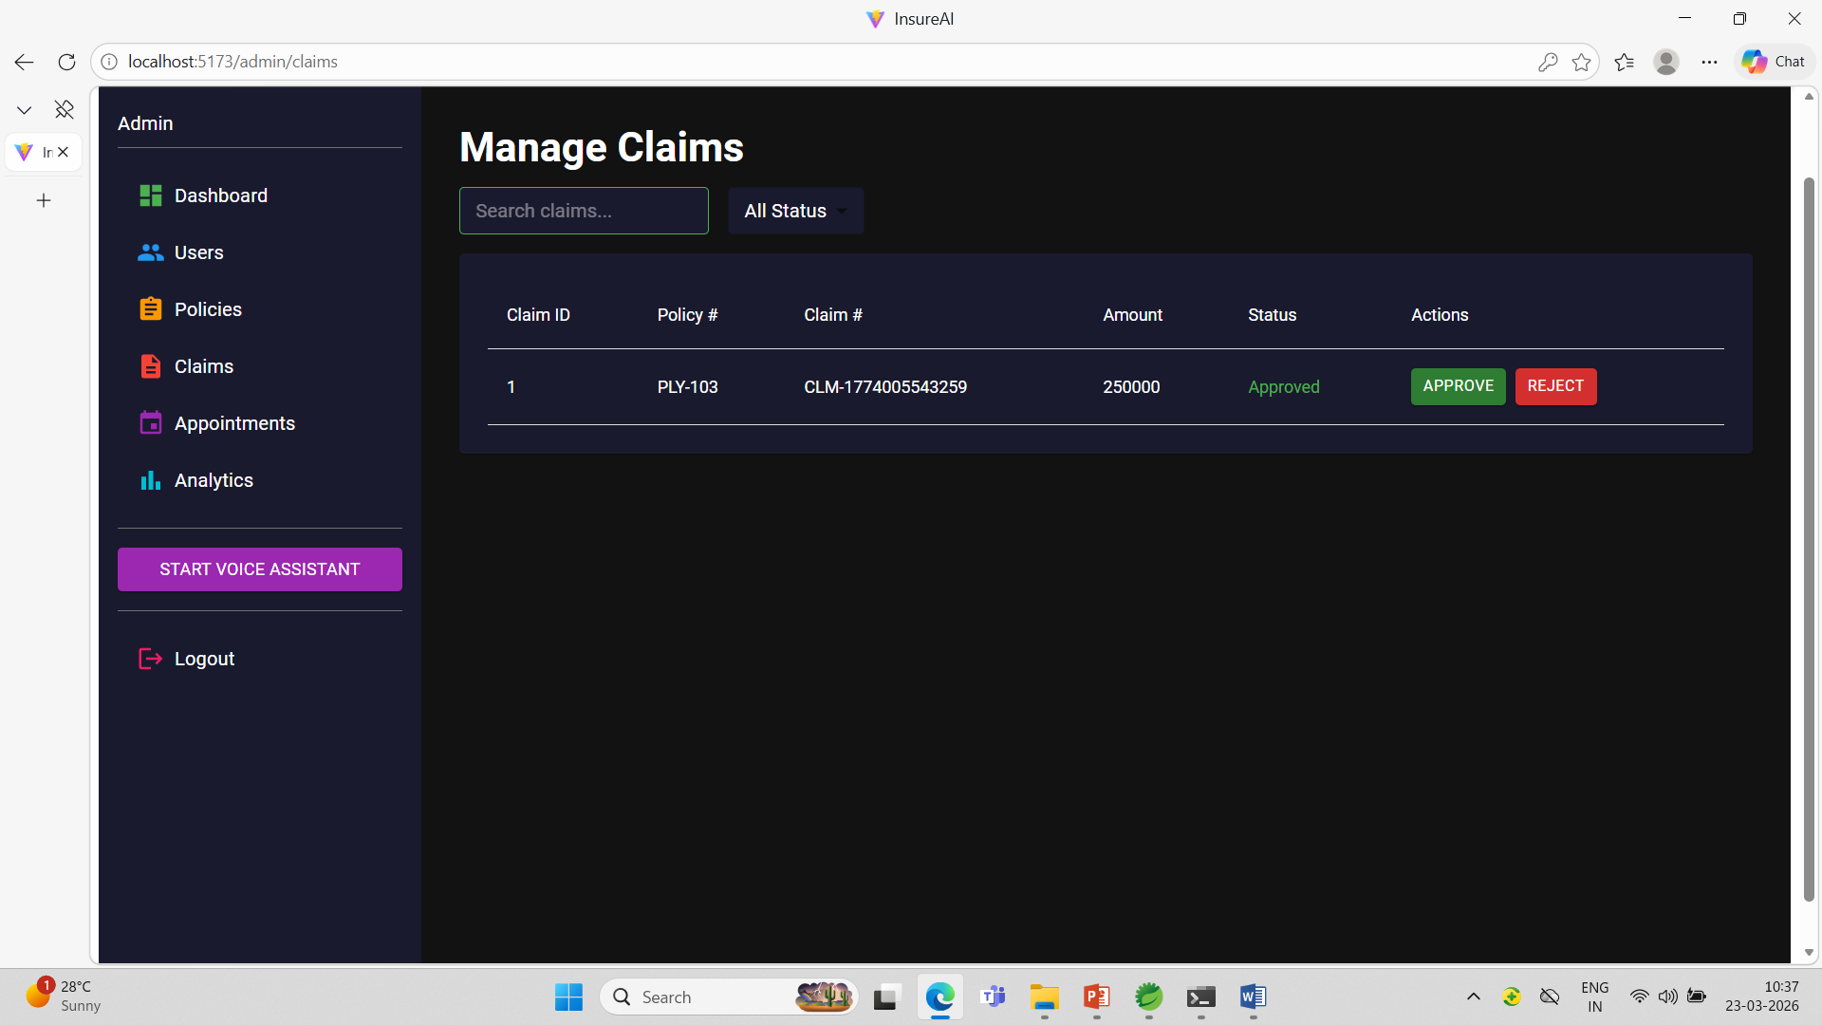
Admin Access

Slide 5
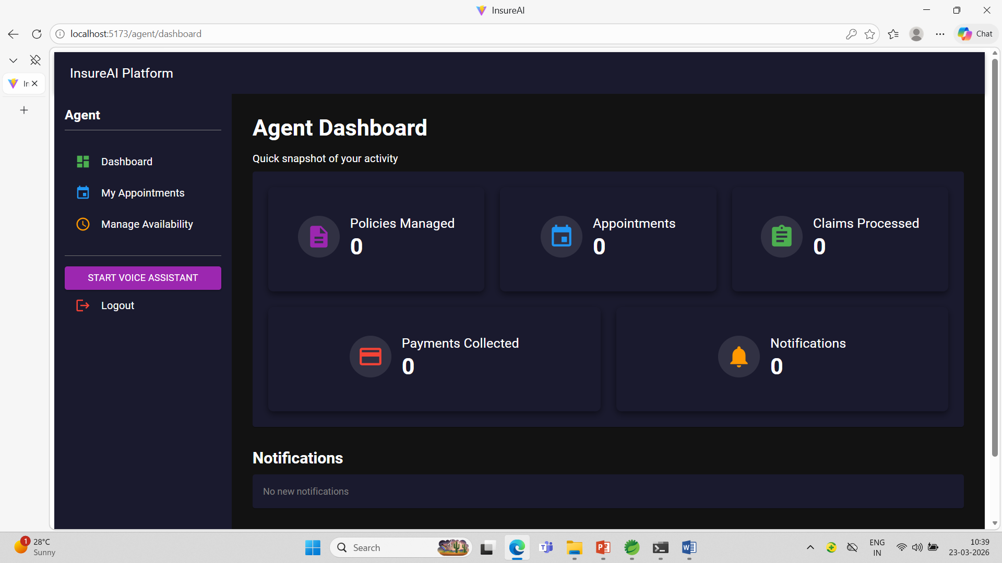
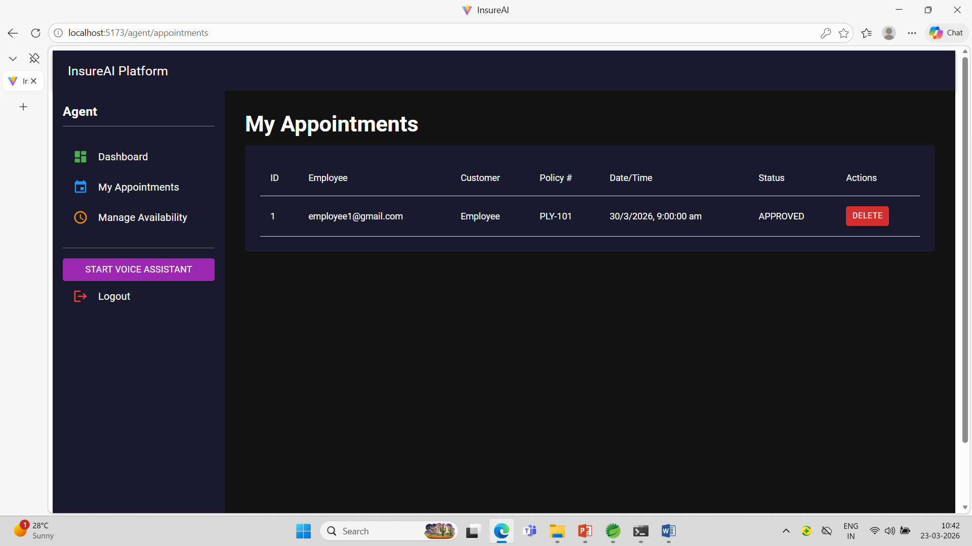
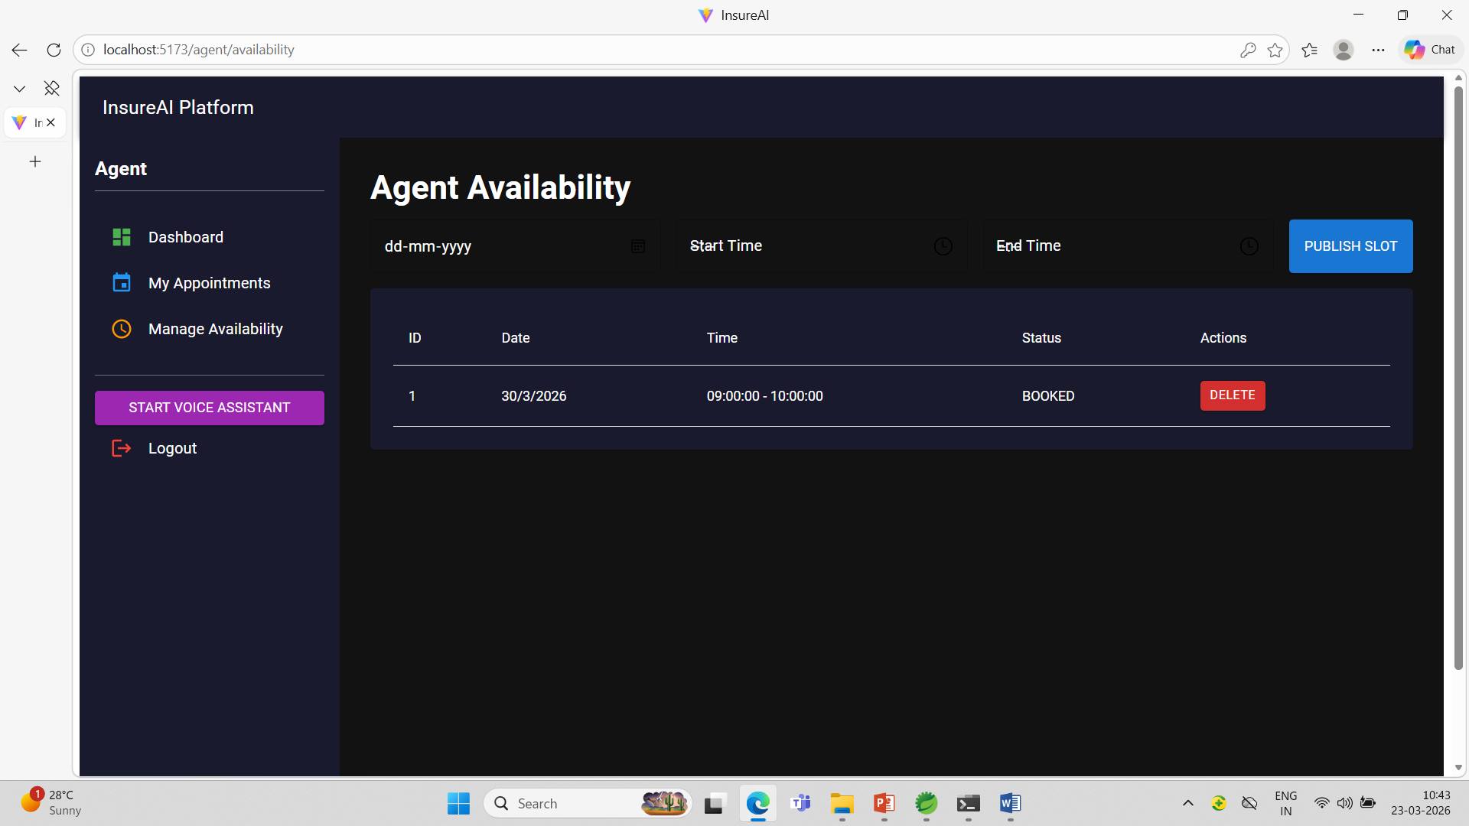
Agent Access

Slide 6
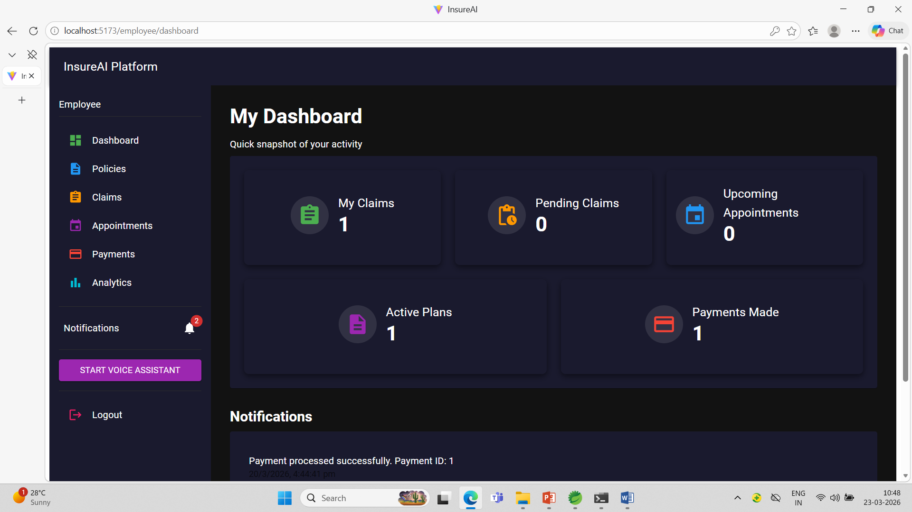
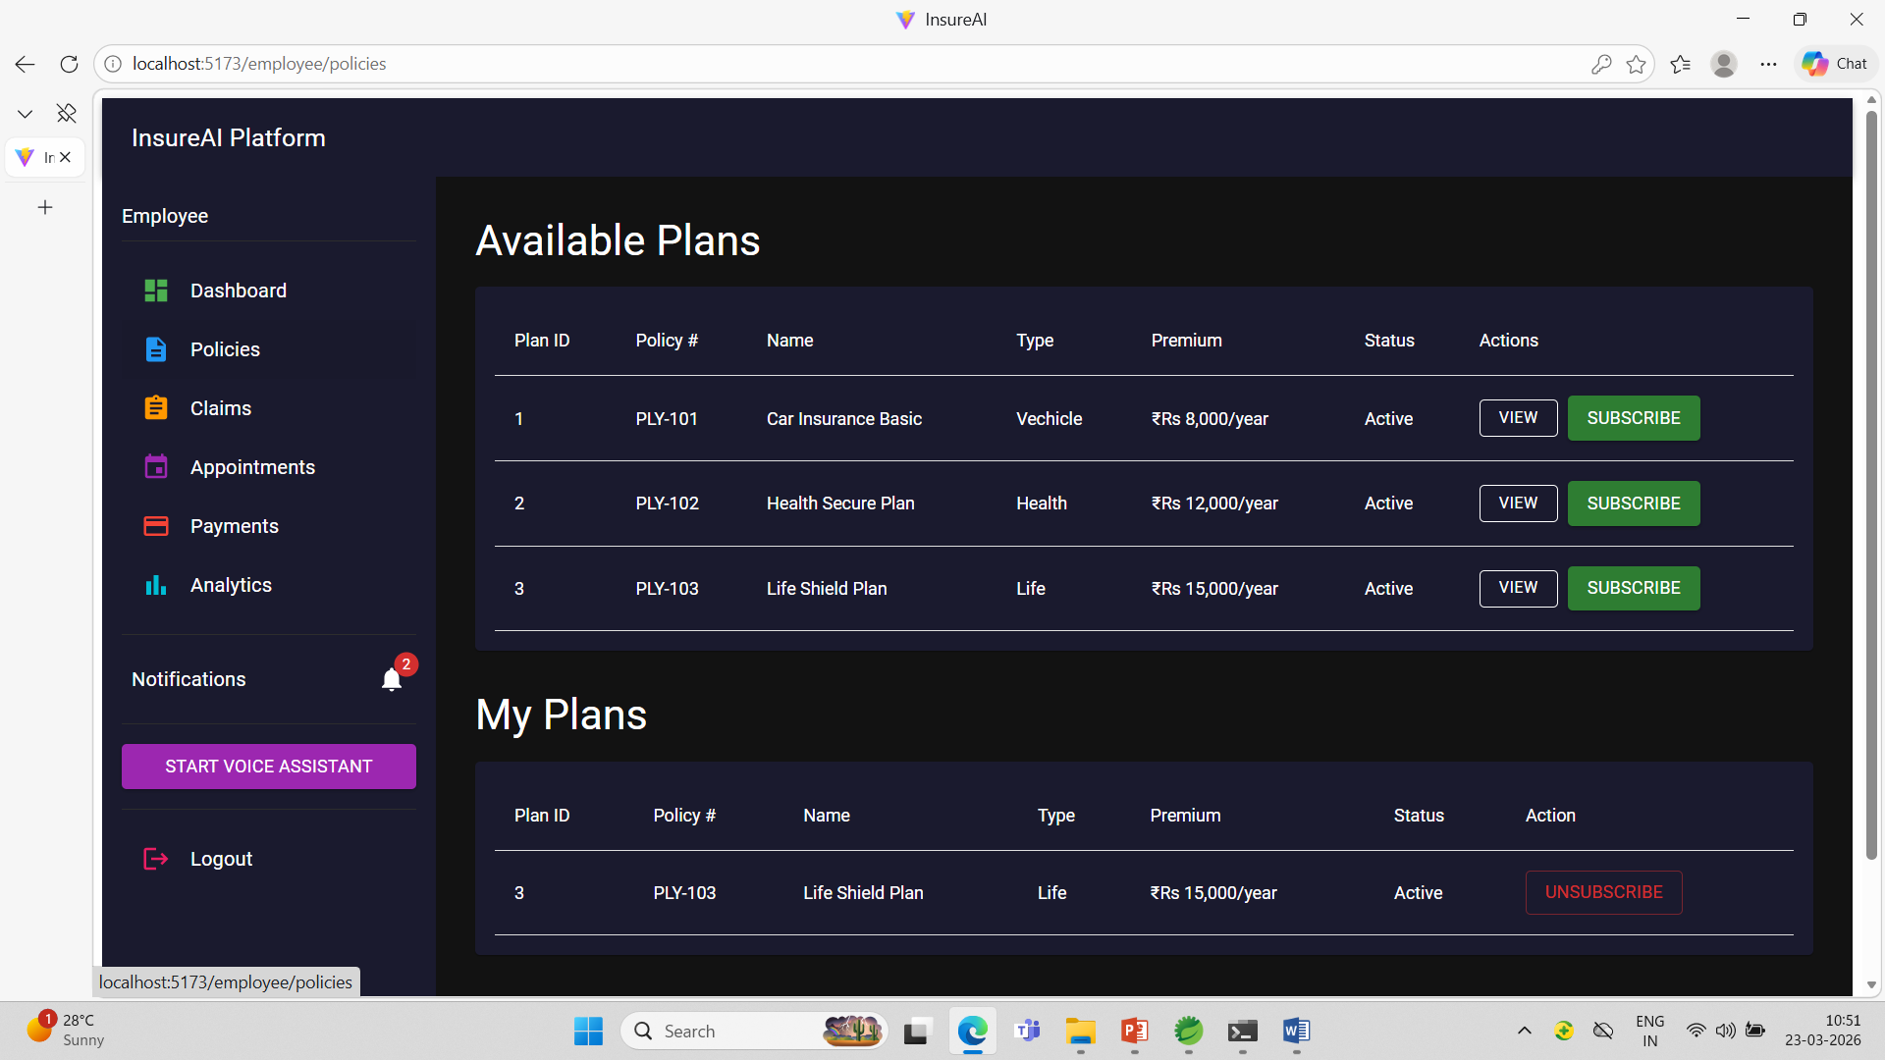
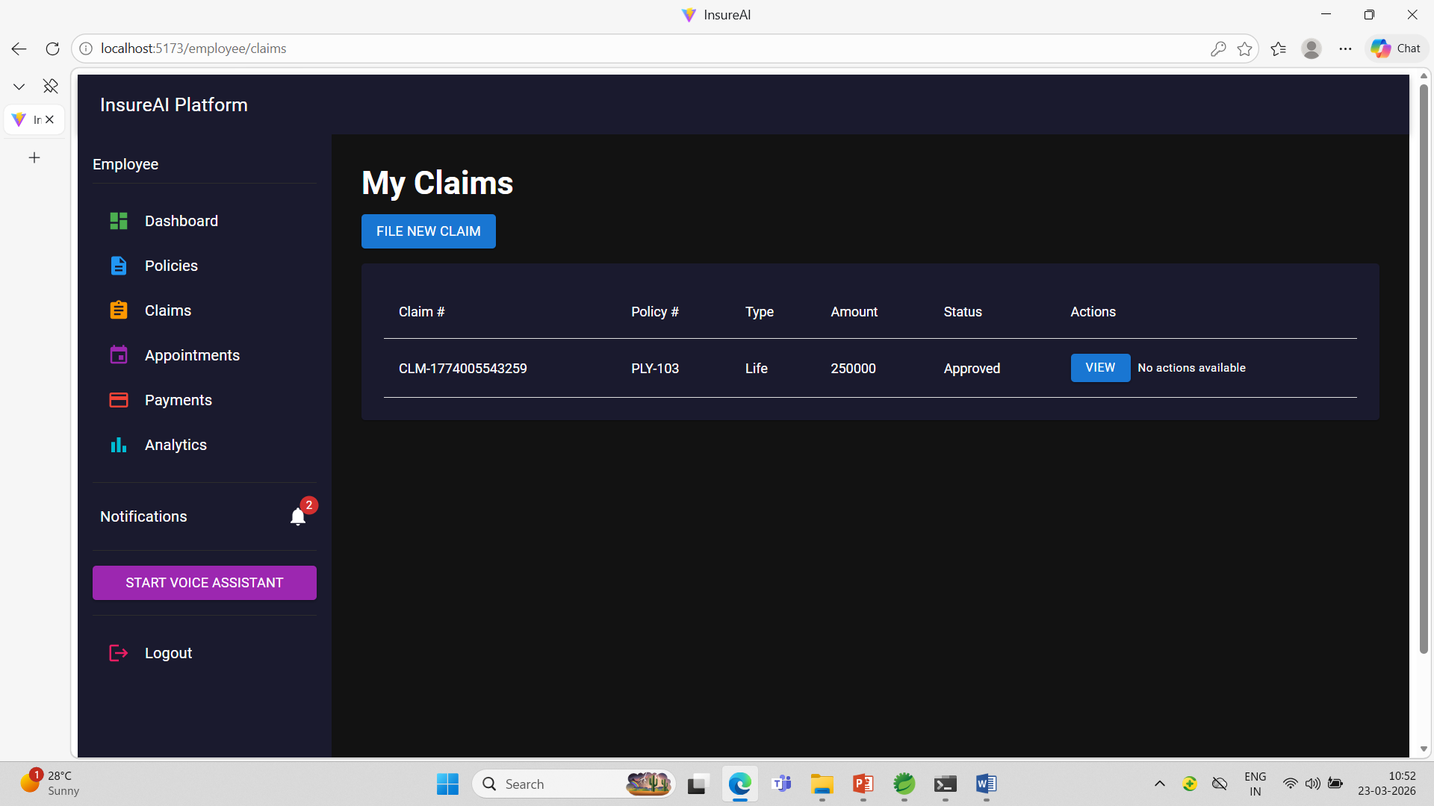
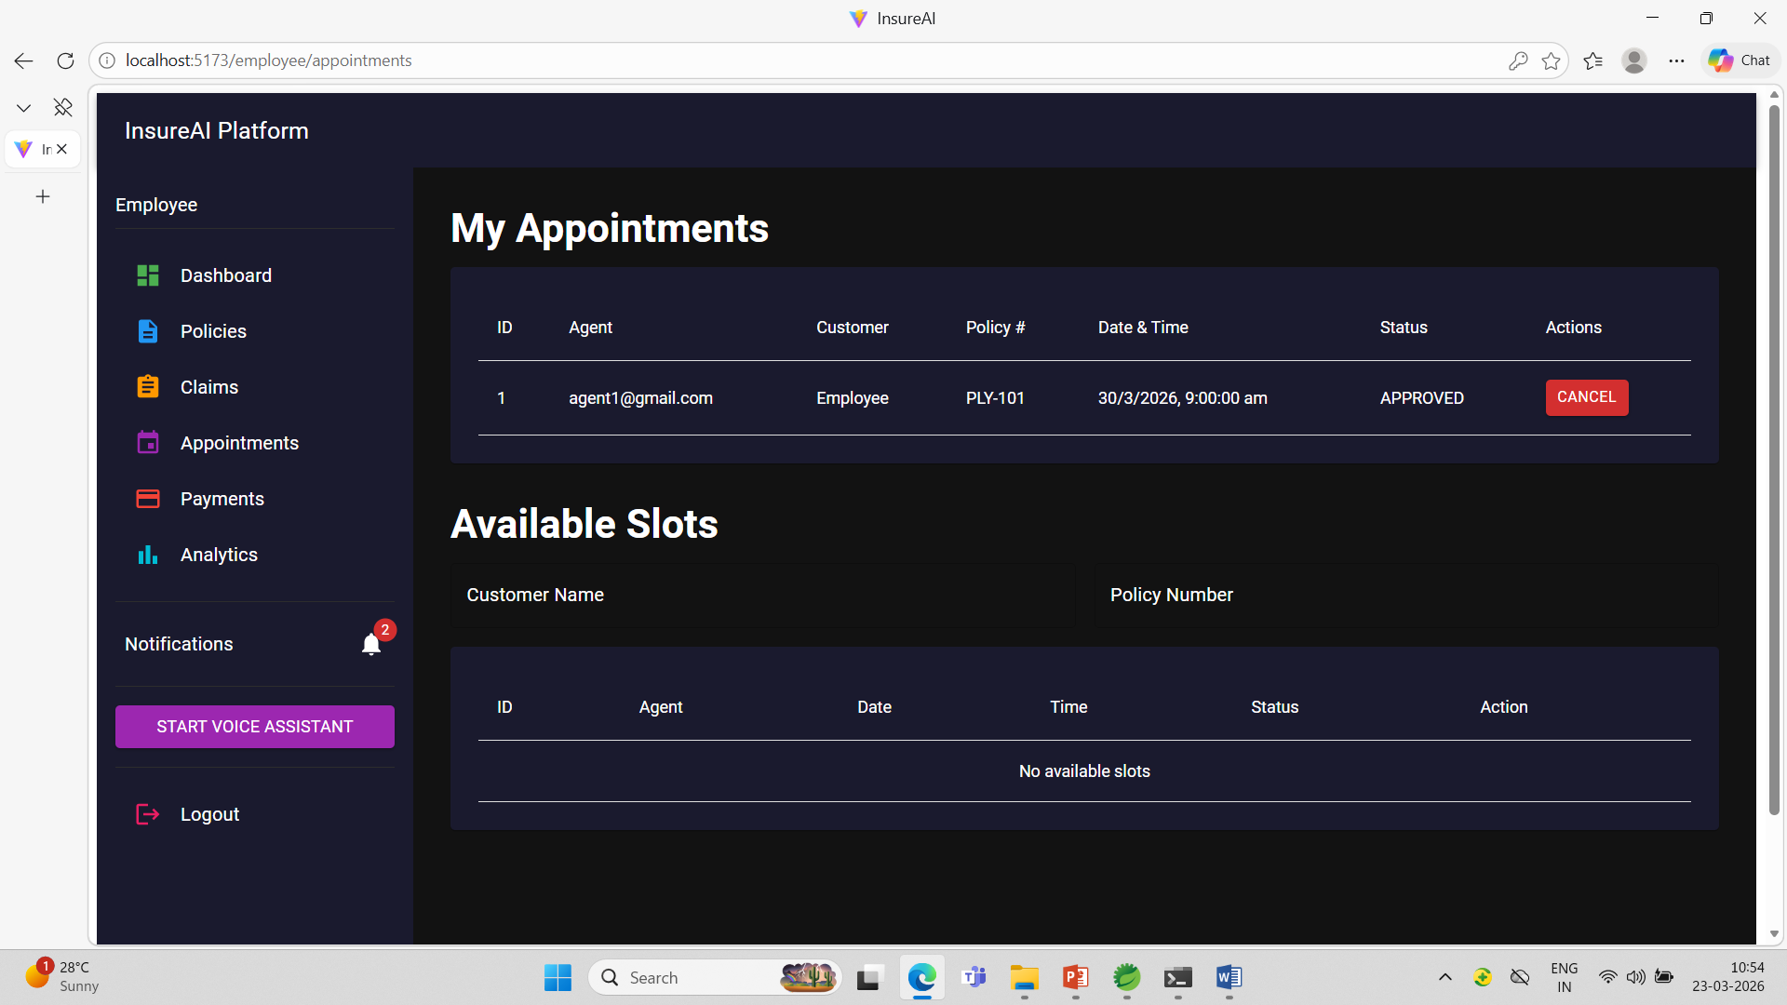
Customer Access

Slide 7
Conclusion
Streamlined Operations: Digitalization simplifies complex insurance workflows for admins, agents, and customers.
Enhanced Efficiency: Saves significant time and resources across all user roles.
Intuitive Experience: User‑friendly design ensures smooth interactions and higher satisfaction.
Future‑Ready Platform: Scalable system with upcoming AI features for personalization and automation.

